Slide 1
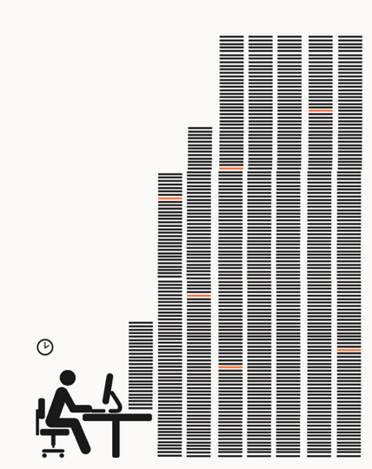

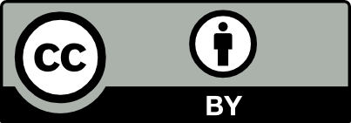
The Right to READ is the Right to MINE
Content-mining (TDM) saves years of work and hugely advances knowledge
Legal, but obstructed by Elsevier
Elsevier records/deanonymises every download
Technical solutions and tools exist
Enforce Mining through contract
Cache content. (? trusted third party)
Do we control Mining or does Elsevier?
With 5 more illustrative slides
PM-R is happy to give more information to negotiators
Peter Murray-Rust, Chemistry
pm286@cam.ac.uk

Slide 2
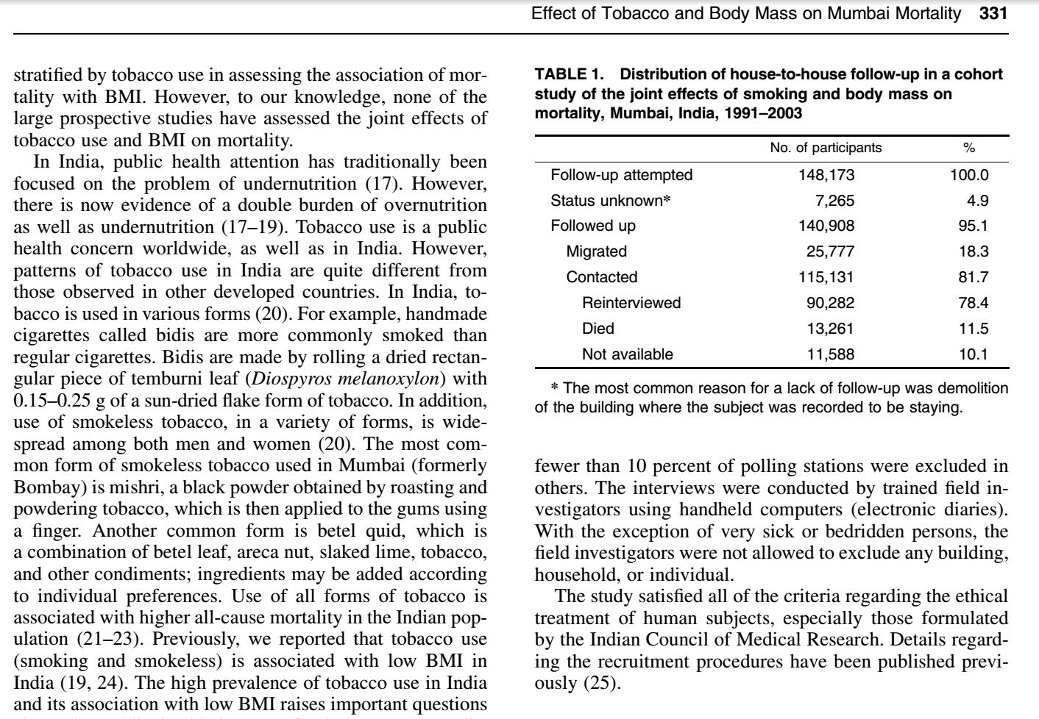
“there were 10,000 abstracts and due
to time pressures, we split this between 6 researchers. It took about 2-3 days of work (working only on this) to get through
~1,600 papers each. So, at a minimum this
equates to 12 days of full-time work (and would normally be done over several weeks under normal time pressures).” UoC researcher
Manual full-text studies take months/years
Existing software can do a lot of this in an hour

Slide 3
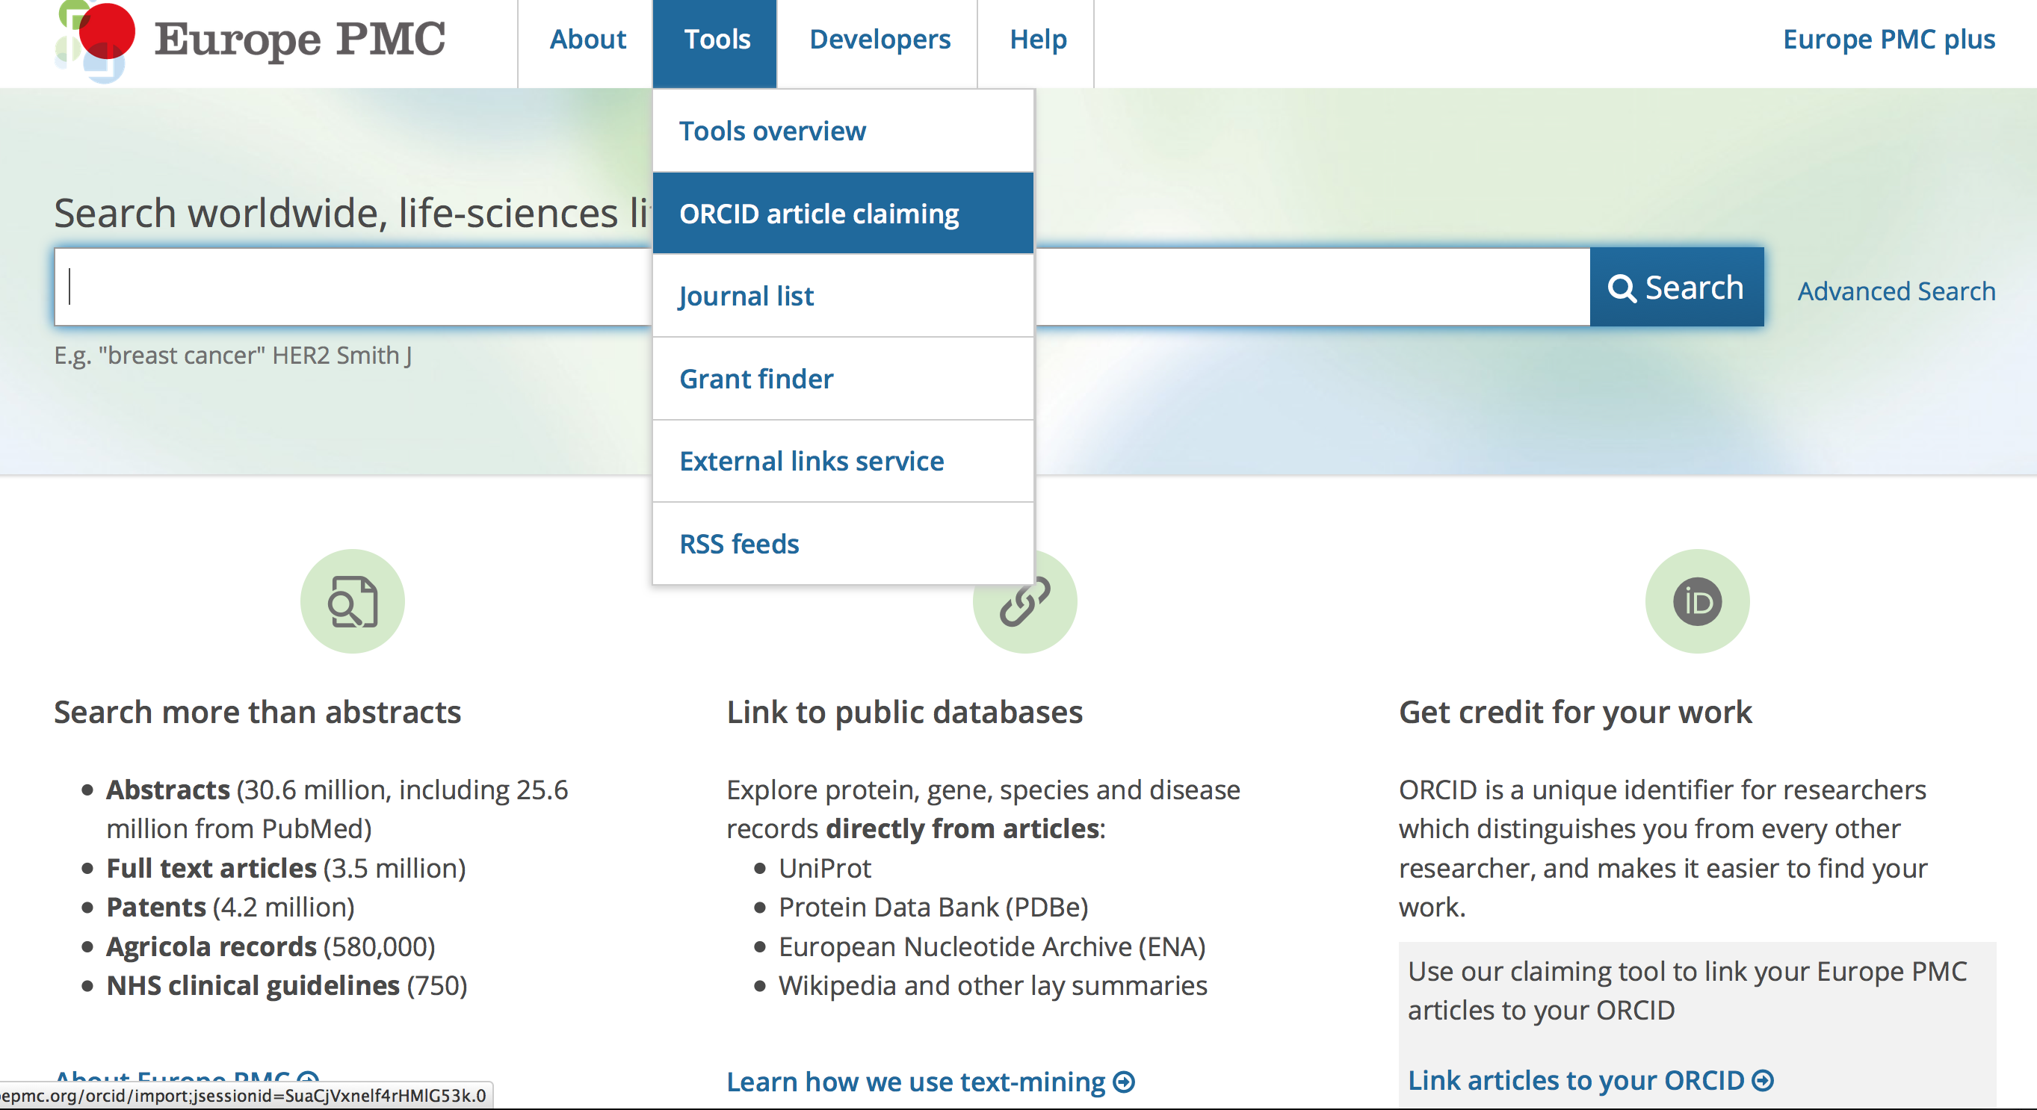
Europe PubMedCentral
We routinely download and mine 500 papers/minute

Slide 4
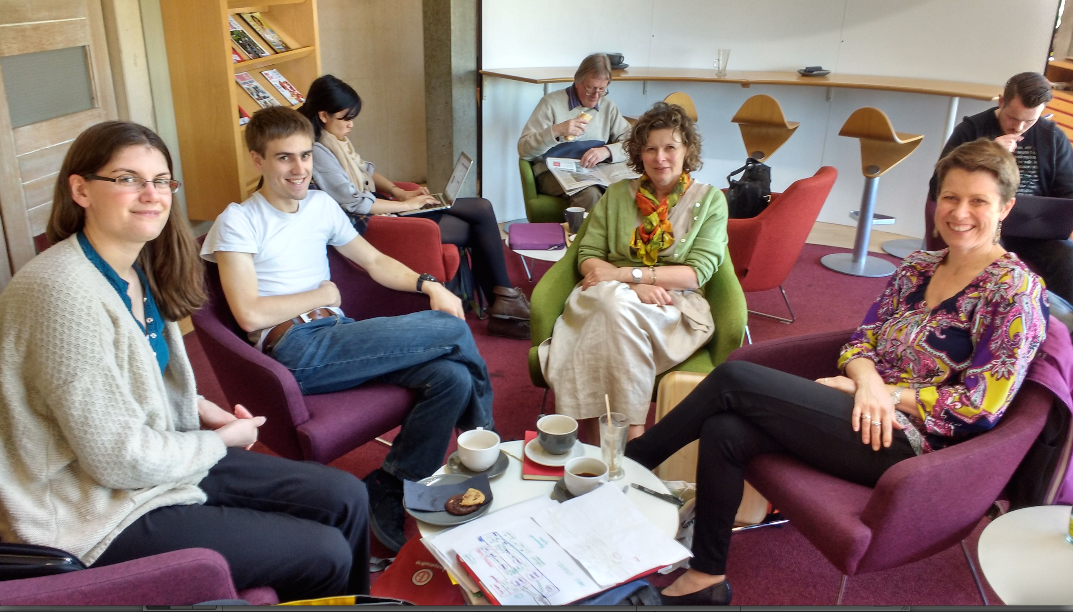
Cambridge: Mining the Daily scientific literature
Jenny Molloy
Tom Arrow
Yvonne Nobis
Danny Kingsley
10,000 articles per day

Slide 5
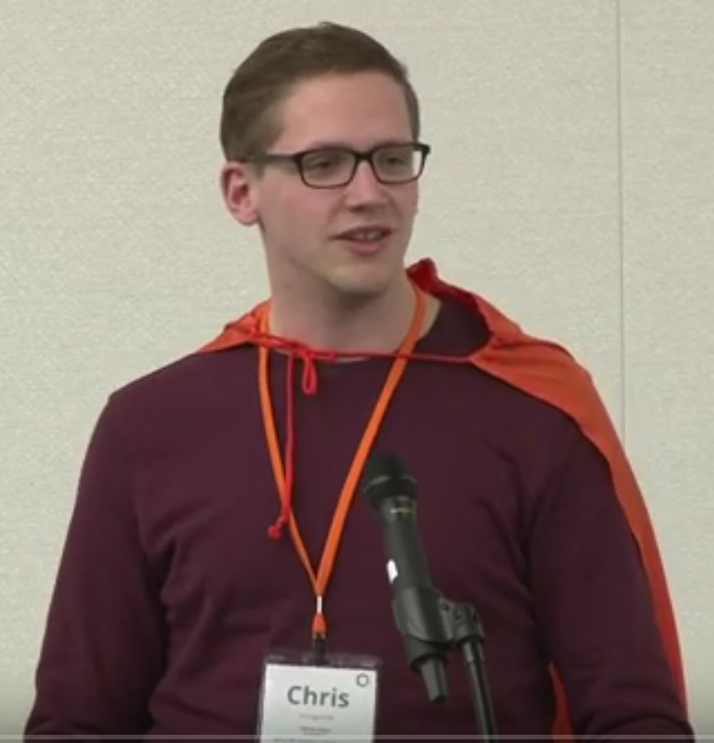
Chris Hartgerink’s (NL) blog post
I am a statistician interested in detecting potentially problematic research such as data fabrication, which results in unreliable findings and can harm policy-making, confound funding decisions, and hampers research progress.
To this end, I am content mining results reported in the psychology literature. Content mining the literature is a valuable avenue of investigating research questions with innovative methods. For example, our research group has written an automated program to mine research papers for errors in the reported results and found that 1/8 papers (of 30,000) contains at least one result that could directly influence the substantive conclusion [1].
In new research, I am trying to extract test results, figures, tables, and other information reported in papers throughout the majority of the psychology literature. As such, I need the research papers published in psychology that I can mine for these data. To this end, I started ‘bulk’ downloading research papers from, for instance, Sciencedirect. I was doing this for scholarly purposes and took into account potential server load by limiting the amount of papers I downloaded per minute to 9. I had no intention to redistribute the downloaded materials, had legal access to them because my university pays a subscription, and I only wanted to extract facts from these papers.
Full disclosure, I downloaded approximately 30GB of data from Sciencedirect in approximately 10 days. This boils down to a server load of 0.0021GB/[min], 0.125GB/h, 3GB/day.
Approximately two weeks after I started downloading psychology research papers, Elsevier notified my university that this was a violation of the access contract, that this could be considered stealing of content, and that they wanted it to stop. My librarian explicitly instructed me to stop downloading (which I did immediately), otherwise Elsevier would cut all access to Sciencedirect for my university.
I am now not able to mine a substantial part of the literature, and because of this Elsevier is directly hampering me in my research.
[1] Nuijten, M. B., Hartgerink, C. H. J., van Assen, M. A. L. M., Epskamp, S., & Wicherts, J. M. (2015). The prevalence of statistical reporting errors in psychology (1985–2013). Behavior Research Methods, 1–22. doi: 10.3758/s13428-015-0664-2
“Elsevier stopped me doing my research”

Slide 6
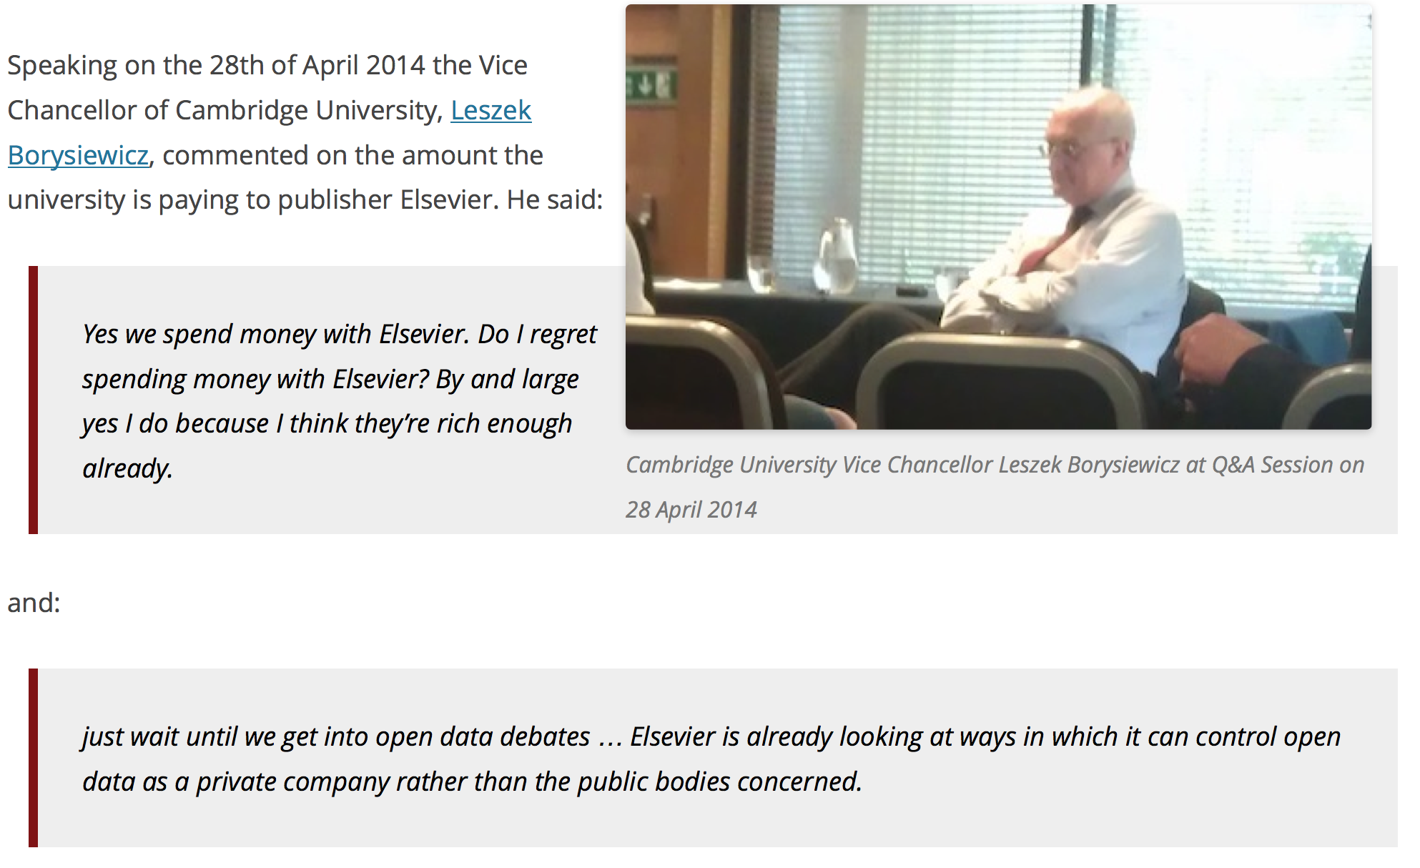
Elsevier wants to control Open Data
[asked by Michelle Brook]

